Slide 1
BCAT® University Online Programs: The BCAT® Test System Training
Presented by:
Dr. William Mansbach
Creator of the BCAT Approach

Slide 2
Why does cognitive assessment matter?

Slide 3
Prevalence of Cognitive Impairment
75-80% of older adults in nursing and assisted living facilities have some form of cognitive impairment
Approximately 25-30% have Mild Cognitive Impairment (MCI)
Approximately 50-60% have dementia
In the community, 15-20% have MCI
In the community, approximately 11% of older adults have dementia

Slide 4
Common Negative Outcomes of Cognitive Misdiagnosis
Sub-optimal management of medical conditions
Inflated rate of hospital readmissions
Increased frequency of falls
Lowered rehabilitation services outcomes
Sub-optimal discharge planning
Increased risk for losing independence

Slide 5
The Cognitive Continuum
Cognition is a “vital sign”
Cognition is at the center of our experience
Cognition consists of multiple domains
The three major cognitive functioning stages:
Normal
Mild cognitive impairment
Dementia

Slide 6
The Three Cognitive Stages
Normal: Inefficiencies, but not pathology
MCI: The four subtypes
Amnestic (aMCI)
Executive (eMCI)
Multi-domain (mMCI)
Undifferentiated (uMCI)
MCI conversions to dementia

Slide 7
The Three Cognitive Stages (continued)
Dementia—a matter of degree
ALWAYS progressive
Affects cognition, mood, behavior, and function
Multiple causes

Slide 8
Neuro-physiology

Slide 9
Basic Brain Structures
Neocortex (cortex)—executive or “higher cortical functions”
Limbic system—“emotional brain” and “memory starter”
Cerebellum—motor control
Brain stem—basic involuntary functions (breathing, heart rate, and blood pressure)

Slide 10
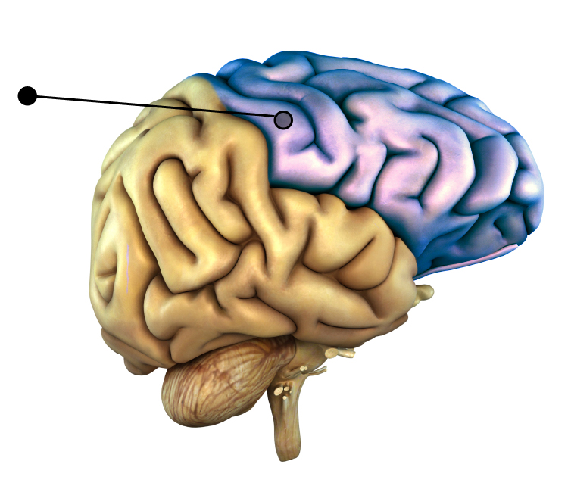
Basic Brain Structures: Neocortex
Frontal Lobes
Executive Processes

Slide 11
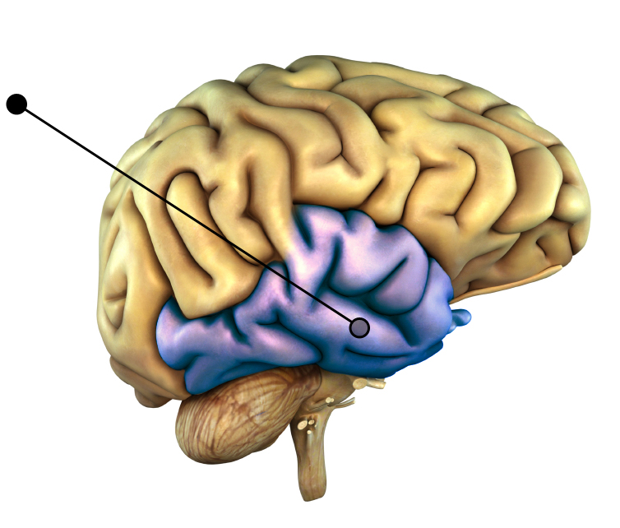
Basic Brain Structures: Neocortex
Temporal Lobes
Learning & Memory

Slide 12
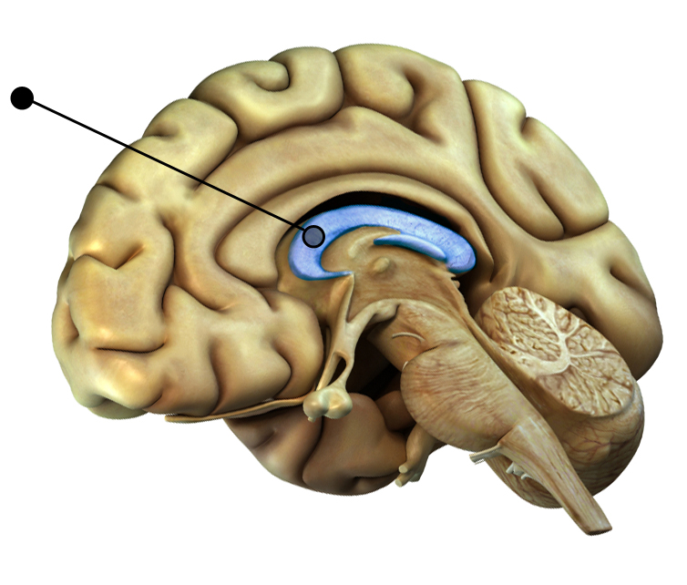
Basic Brain Structures: Limbic System
Hippocampus
Early Memory Stage

Slide 13
The BCAT® Test System

Slide 14
Background on Cognition & Assessment
Problems with Existing Cognitive Instruments:
Sensitivity and specificity
Not predictive of function
Relatively weak on assessing memory
Relatively weak on assessing executive functions

Slide 15
Commonly Used Cognitive Screening Tools
Mini-Mental State Examination (MMSE)
Short Test of Mental Status (STMS)
Montreal Cognitive Assessment (MoCA)
Saint Louis University Mental Status Examination (SLUMS)
Brief Cognitive Assessment Tool (BCAT®) & BCAT®-SF
Brief Interview for Mental Status (BIMS)

Slide 16
The BCAT® Test System

Slide 17
The BCAT® Test System – The Six Tests
The Test System is a comprehensive approach for rapid assessment of memory, executive functions, and attentional capacity.
The “Full” BCAT® (21-items) is the featured test.
The other four tests make unique contributions to assessment.
We recommend administering the BCAT® and BADS® first.
The System is an excellent method for tracking cognitive and mood changes over time.

Slide 18
The BCAT® Test System – The Six Tests
All tests have interactive online scoring programs with test reports.
All six tests have undergone rigorous testing, peer-reviews.
Multiple publications, professional presentations
The BCAT® Test System is supported by the BCAT® Research Center.

Slide 19
The BCAT®

Slide 20
The Brief Cognitive Assessment Tool (BCAT®)
Several development and validation studies
21 items
50 possible points
10-15 minutes to administer

Slide 21
The Brief Cognitive Assessment Tool (BCAT®)
Memory and Executive Functions Factors
Full, Memory Factor, Executive Functions Factor scores
Predicts: ADL, IADL, “falls,” residential placement, “person-centered” ability to participate in care decisions
Interactive website scoring program with test report

Slide 22
BCAT® Item Detail

Slide 23
BCAT® Item Detail

Slide 24
BCAT® Item Detail

Slide 25
BCAT® Item Detail

Slide 26
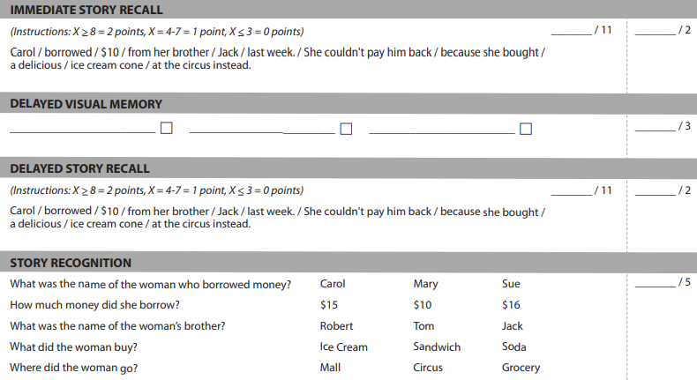
BCAT® Item Detail

Slide 27
The BCAT® Short Form
(BCAT®-SF)

Slide 28
The BCAT® Short Form (BCAT®-SF)
What is it?
Abbreviated version of the full BCAT®
Can be administered in about three (3) minutes
Pulls from the three full BCAT® clusters
Attention
Contextual Memory
Executive Functions

Slide 29
The BCAT® Short Form (BCAT®-SF)
What is it?
Has six items
21 points
Can be scored online
Has a test report
“Cut” score differentiating dementia, MCI (without subtypes), and normal

Slide 30
The BCAT® Short Form (BCAT®-SF)
When to use it?
When time is very short
When the patient can’t tolerate more than a few minutes
A quick assessment once a full BCAT® baseline has been established
Often used in primary care offices

Slide 31
The BCAT® Short Form (BCAT®-SF)—Item Detail

Slide 32
The BCAT® Short Form (BCAT®-SF)—Item Detail

Slide 33
The BCAT® Short Form (BCAT®-SF)—Item Detail

Slide 34
The BCAT® Short Form (BCAT®-SF)—Item Detail

Slide 35
The BCAT® Short Form (BCAT®-SF)—Item Detail

Slide 36
The Kitchen Picture Test of Judgment (KPT®)

Slide 37
The Kitchen Picture Test (KPT®) of Judgment
The KPT® was developed because:
there were too few tools for older adults.
many of these instruments have poor psychometrics.
most of these measures are designed for a limited number of clinicians.
existing tools are too cumbersome to use efficiently.

Slide 38
The Kitchen Picture Test (KPT®) of Judgment

Slide 39
The Kitchen Picture Test (KPT®) of Judgment
Can be administered in less than five minutes
Appropriate for trained professionals and techs
Based on visual stimuli to put the patient “into the situation”
Strong psychometrics
“Cut” scores: judgment consistent with dementia versus non-dementia

Slide 40
The Kitchen Picture Test (KPT®) – Item Detail

Slide 41
The Kitchen Picture Test (KPT®) – Item Detail

Slide 42
The Kitchen Picture Test (KPT®) – Item Detail

Slide 43
The Brief Anxiety and Depression Scale (BADS®)

Slide 44
The Brief Anxiety and Depression Scale (BADS®)
Can be administered in less than three (3) minutes
Can be used as a “process” instrument over time
Has a “cut” score to differentiate those with and without anxiety symptoms
Has a “cut” score to differentiate those with and without depressive symptoms
Has strong reliability, construct validity, and predictive validity

Slide 45
The Brief Anxiety and Depression Scale (BADS®)
Comprised of eight items
Has strong sensitivity and specificity (“cut” scores)
Assesses for symptoms of Generalized Anxiety Disorder
Combines depressive symptoms and diagnosis of major depressive episode
Score range from 0 – 16
Is appropriate for all trained professionals and techs

Slide 46
The Brief Anxiety and Depression Scale (BADS®)
Scoring and Interpretation
Enter the scores using the Online BAD® Test
The test report identifies those who are likely to have a Generalized Anxiety Disorder
The test report identifies those who are likely to have significant depressive symptoms or an actual depressive episode

Slide 47
The Brief Anxiety and Depression Scale (BADS®)
Scoring and Interpretation (continued)
If “positive” screen, consider a referral for a more comprehensive evaluation
Consider the impact of anxiety and depression on cognition, function, and rehab outcomes

Slide 48
The BADS® – Item Detail

Slide 49
The BADS® – Item Detail

Slide 50
The Verbal Test of Practical Judgment (VPJ®)

Slide 51
The Verbal Test of Practical Judgment (VPJ®)
The VPJ® was developed because:
impaired judgment creates safety risks that negatively impact a person’s ability to function independently.
there is a shortage of ecologically valid measures to assess judgment.

Slide 52
The Verbal Test of Practical Judgment (VPJ®)
The VPJ® was developed to:
assess judgment and predict a person’s ability to successfully manage basic activities of daily living (ADL) and instrumental activities of daily living (IADL)
inform hospital and rehab staff in patient discharge planning.
to help clinicians evaluate patient decision-making skills.
detect possible judgment concerns in people who have more nuanced or inconspicuous cognitive deficits.

Slide 53
The Verbal Test of Practical Judgment (VPJ®)
The VPJ® scores correspond to three judgment levels:
No apparent judgment issues
Some judgment issues
Severe judgment issues

Slide 54
The VPJ® – Item Detail

Slide 55
The VPJ® – Item Detail

Slide 56
The VPJ® – Item Detail

Slide 57
The VPJ® – Item Detail

Slide 58
The VPJ® – Item Detail

Slide 59
The Brief Cognitive Impairment Scale (BCIS®)

Slide 60
The BCIS® for Severe Impairment
Brief Cognitive Impairment Scale (BCIS®) – Used for:
BCAT® scores <25 (guideline)
Assessing severe cognitive impairment
Tracking cognitive changes over time
Creating behavior plans
Assists caregivers in providing personal care

Slide 61
The BCIS® for Severe Impairment
Measures:
Simple cognitive processing
Complex cognitive processing
Interpersonal tolerance

Slide 62
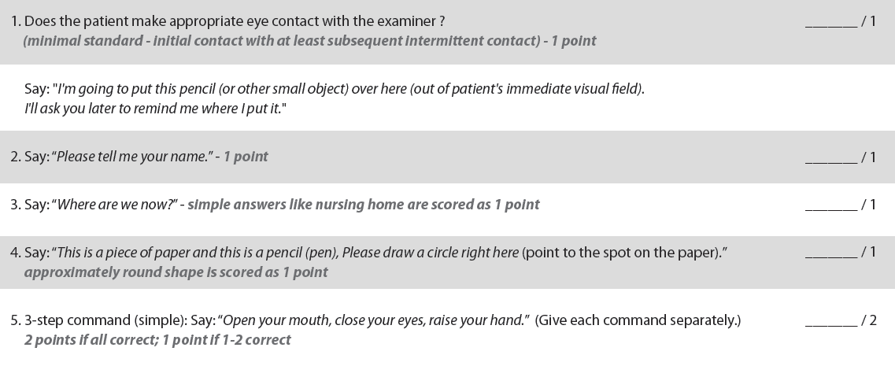
The BCIS® for Severe Impairment

Slide 63
The BCIS® for Severe Impairment

Slide 64
The BCIS® for Severe Impairment
Scoring and Interpretation
Enter the scores using the Online BCIS® Test
Generates a test report
Can be used repeatedly as a “process tool
Helpful in managing the milieu

Slide 65
The BCAT® Approach Summary

Slide 66
Advantages of Online Test Reports
Reduce mathematical errors
Can help with diagnostic accuracy
Can help standardize clinical interpretations
Can be integrated into an Electronic Health Record
Are more portable
Online Test Reports should enhance, but not replace the clinical judgment.

Slide 67
Improve Patient Cognitive Function
Now that you know how to use the BCAT® Test System, would you like to learn how to improve memory and cognition of your patients?
Check out the BCAT® education modules to learn more about The BCAT® Intervention programs including: the BCAT® Working Memory Exercise Books, the MemPics® book series, online BCAT® Brain Rehabilitation Modules, and the ENRICH® program.

Slide 68
Contact Us – Mansbach Health Tools, LLC
info@thebcat.com
The BCAT®
Mansbach Health Tools, LLC
PO Box 307
Simpsonville, MD 21150

